Slide 1
”Lists”
By Brandon Tarney
JHU 605.487
5/5/2018

Slide 2
About My App
Todo/lists app (like reminders)
Basic concepts/data-flow:
Lists have 0 – N todos
Todos each belong to 1+ lists
You can select any List to display its Todos
Smart Lists have 0 - N lists
Smart lists allow you to combine lists, and display only the Todos which are present in ALL lists in the smart list AND have “started”
A smart list composed of lists “homework” and “top priority” will show ONLY “top priority homework” todos

Slide 3
UI Concept Art
The concept of a “view” and of a “tag” were combined into the concept of a list.

Slide 4
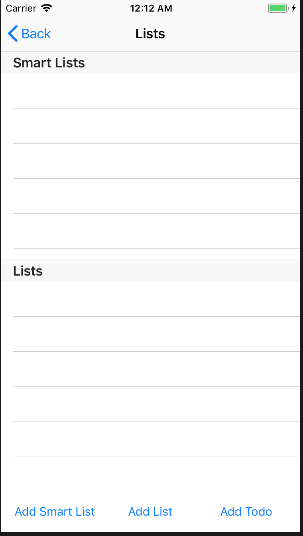
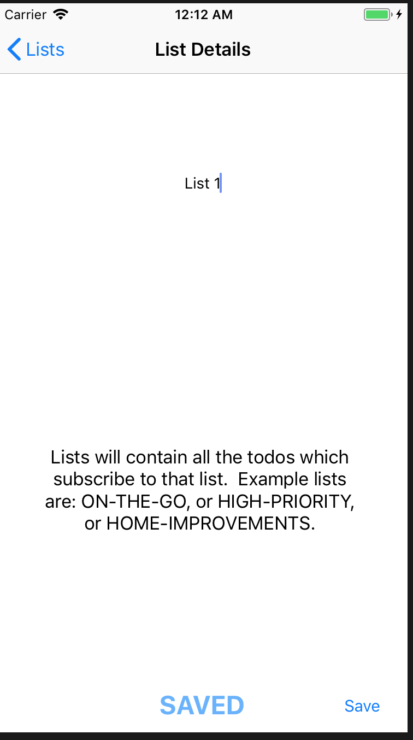
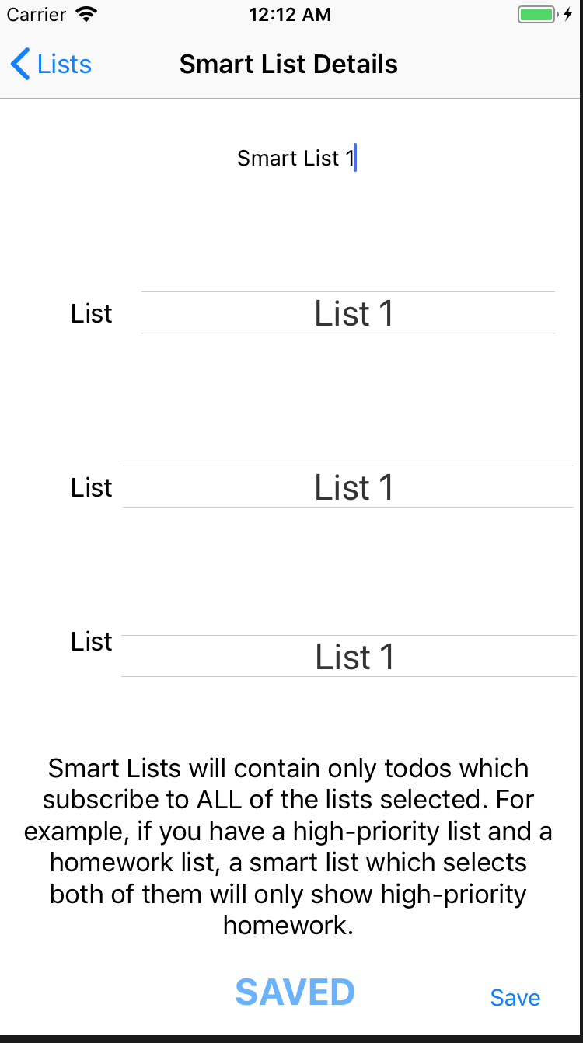
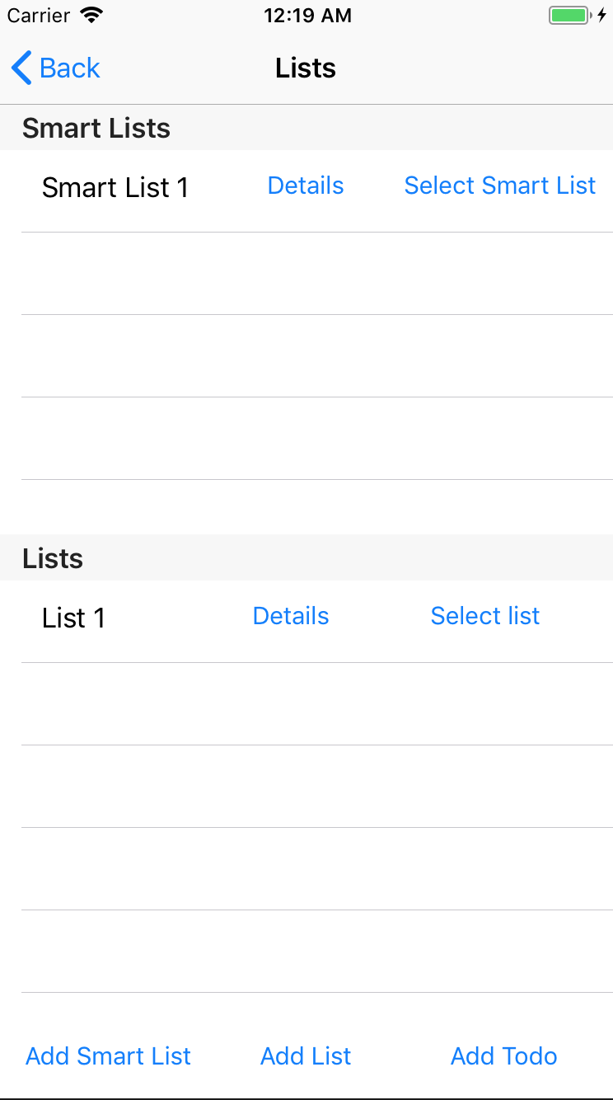
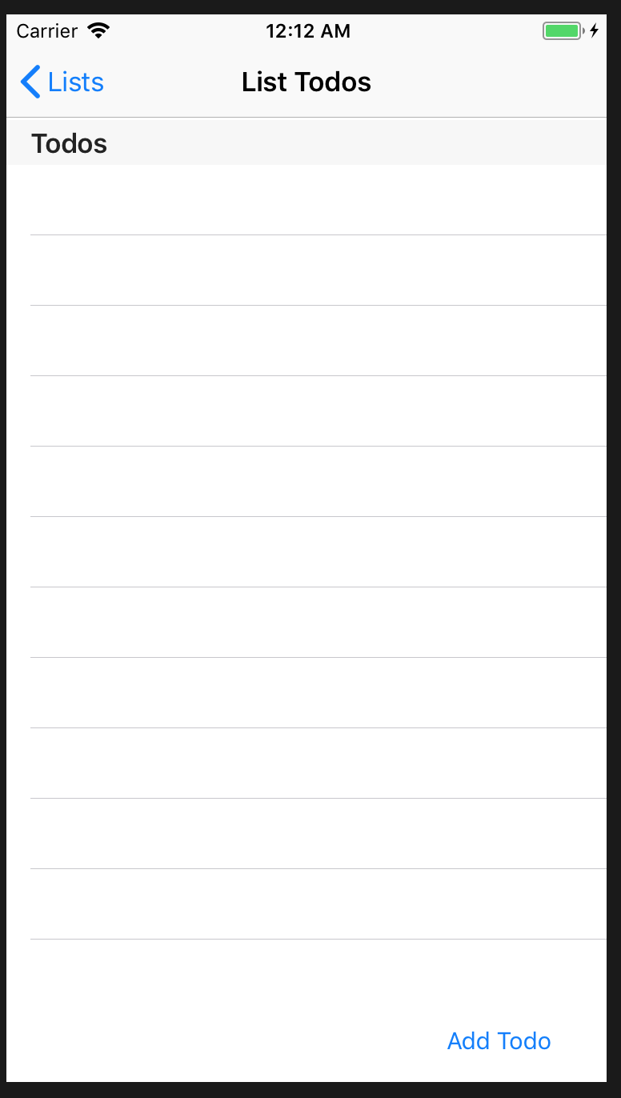
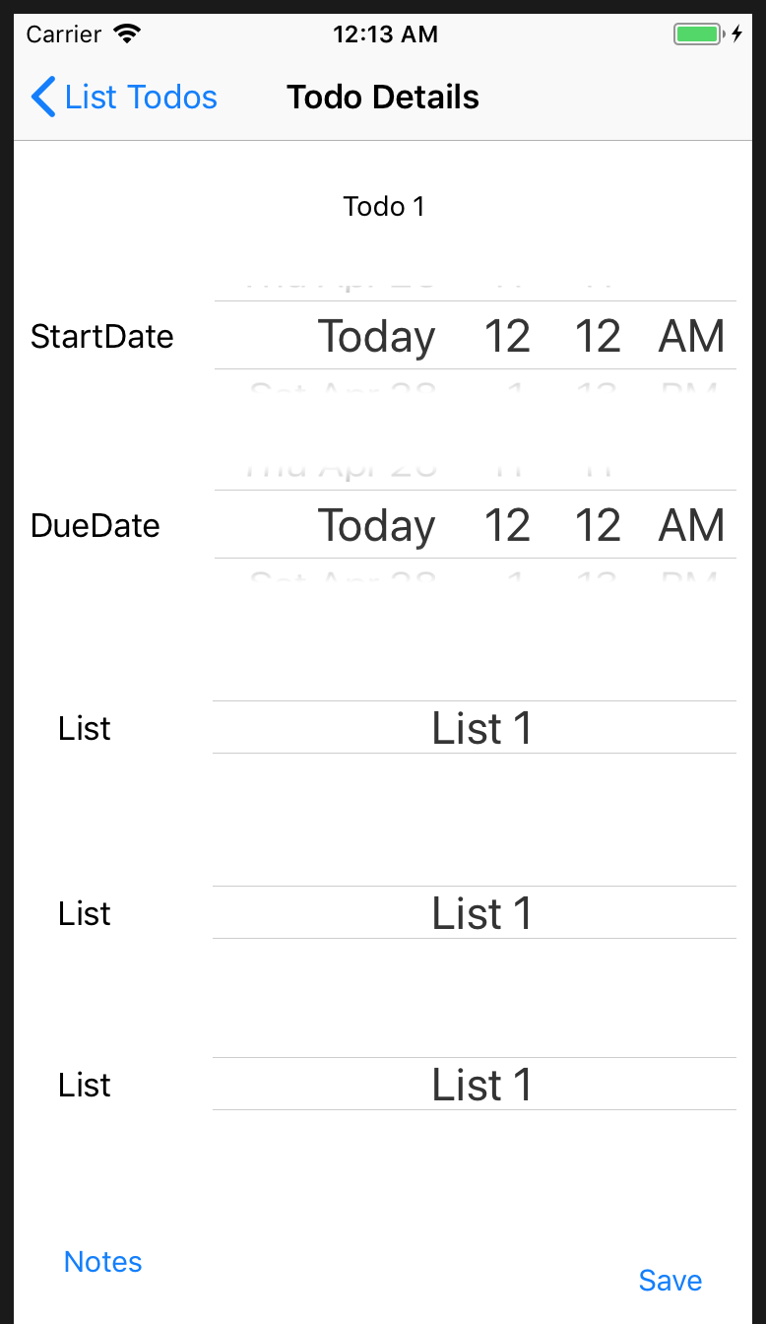
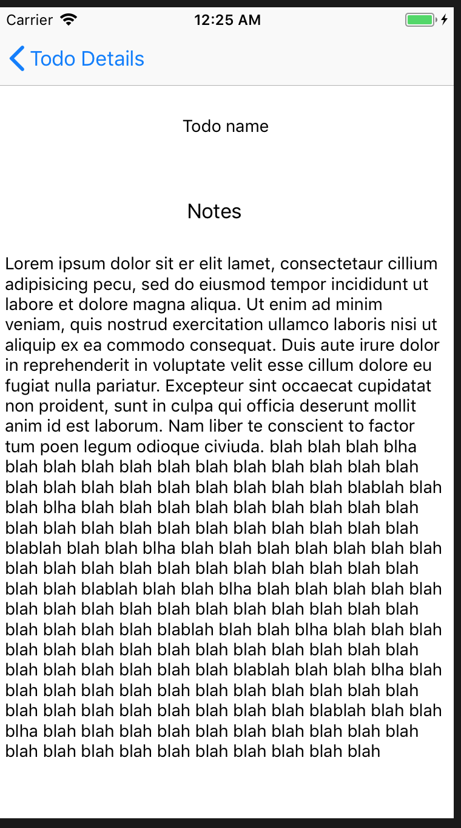
App UI & General Storyboard

Slide 5
Data Model/Flow Design

Slide 6
Actual Data Model

Slide 7
Constraints
Scales all iOS device class sizes

Slide 8
Constraints
No rotation, portrait only
Portrait location locked!

Slide 9
iOS Concepts Used
UIViewControllers:
UINavigationViewController
Embedded UIViewControllers
UITableViewController
Custom UITableViewCell
UIComboPicker
Segues (programmatic & interface-builder derived)
Constraints
Core Data
Data model builder & classes
Relationships, 1-many, many-many
Extensions
Gestures
Notifications

Slide 10
Challenges
Xcode bugs
1 – many relationship
Xcode Indexing
LIES/delays updating predicted build status
Abstract problems:
Core Data limitations
Custom & Embedded UI
”Business Logic”
Managing relationships and queries
Managing object references
Large amount of UI to set/test
Large amount of functionality to test
Feature excitement and creep!

Slide 11
Lessons Learned
Know your app domain
Table stake features
Missing features/market gaps
User expectations
Business model
Design data flow & UI first (save rework time!)
Build MVP FIRST!
Test periodically so xcode doesn’t scare you
Design for usability
Tons of work just to test & polish
Maybe use test flight!
Use ”//MARK: - XXX”
Use extensions
Segue programmatically
Do constraints last
Use relative constraints
Use suggested constraints when yours don’t work
Use Version Control (especially as an xcode newbie)
If when xcode bugs out, try the following:
Clean & Build, Restart xcode, Clean & Build, delete app in simulator, re-deploy

Slide 12
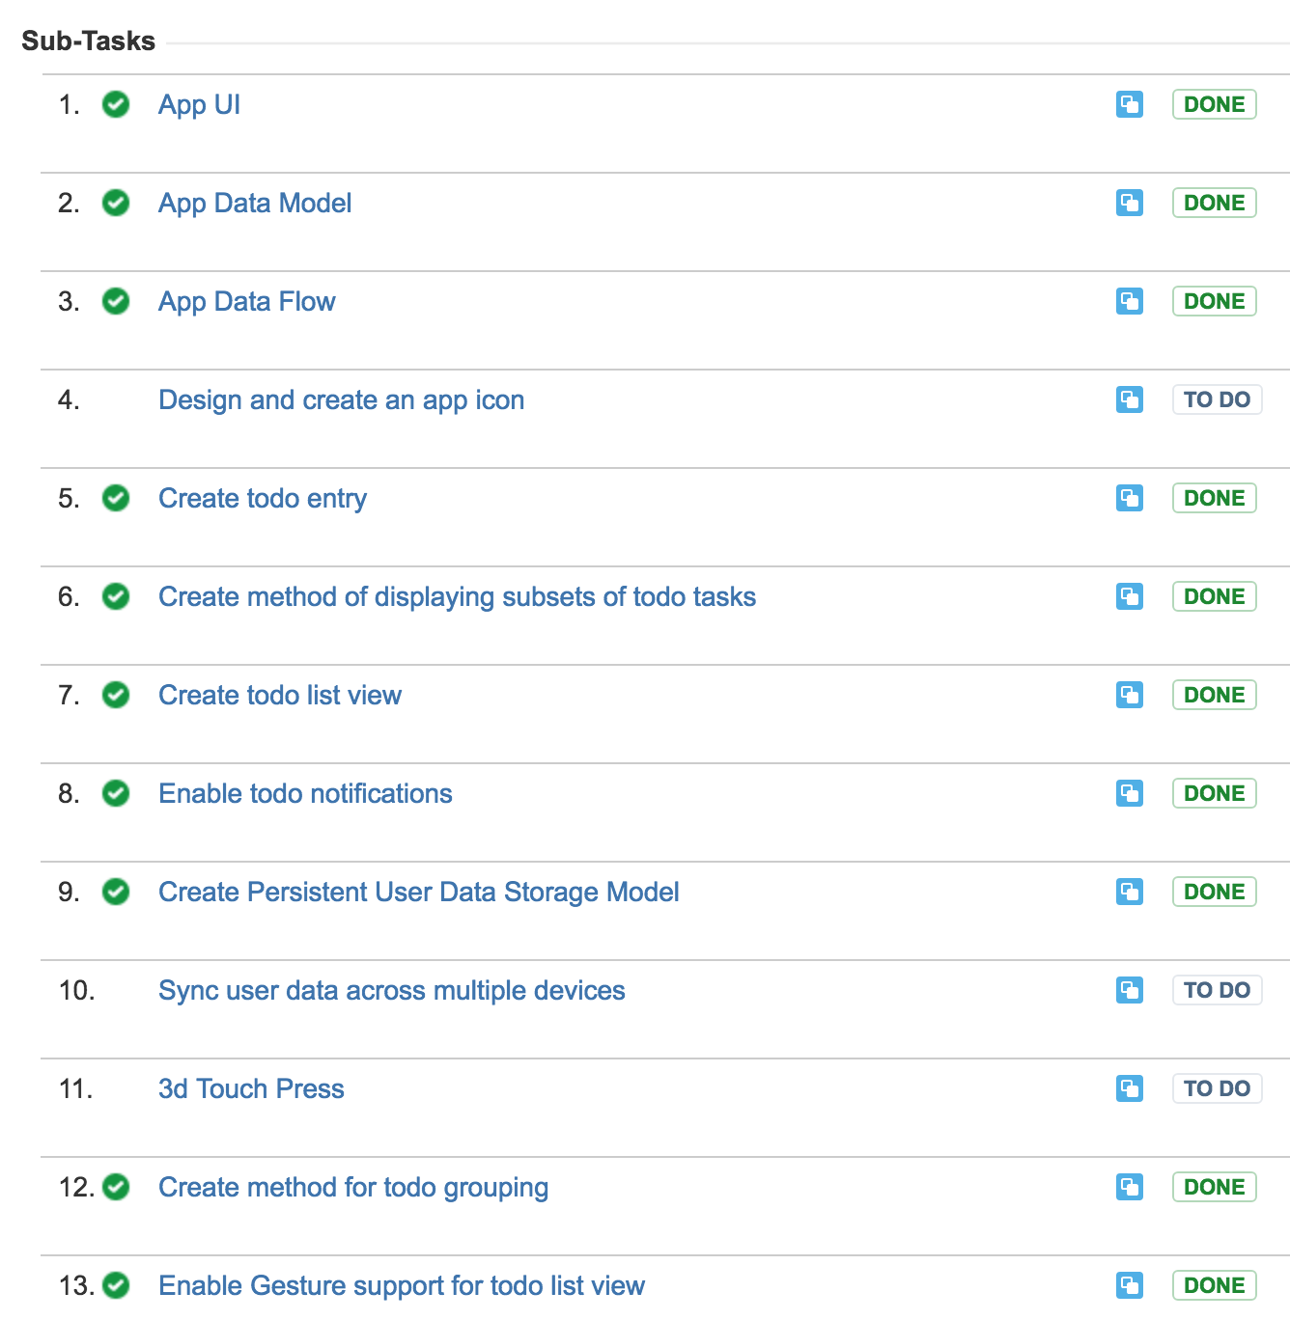
Status/JIRA
Most items complete
Didn’t have time to add the bells and whistles

Slide 13
Future Plans
App Icon
> 3 lists per Smart-List & TODO
Customizability & settings:
Smarter smart lists (inclusive vs. exclusive sets, default lists, how to manage TODO times)
Coloring todos
Default lists (like “ALL”)
3d touch press for “add todo”
UI Updates:
More color
Add button and text outlines so the interface isn’t SO sparse
Smart app on-boarding (appear at first, disappear after use)
Support Landscape mode
Support advanced UI for iPad
Sync data via iCloud
Siri intent support
Advanced testing
LOTS of data
Dog-food it
Test Flight?
Release in the app store?
Depends on how much of the above I get done!
Mac App?! MARZIPAN

Slide 14
DEMO TIME
(And thanks! Class was enjoyable and everyone was super helpful and nice. )

